Slide 1
Lemma’s of RB Tree and Deletion in RB Tree
BY:
NIYATI(18/94062)
SOMYA CHANDRA(18/94027)
JAGRITI VERMA(18/94058)

Slide 2
Lemma’s of RB TREE
Consider a subtree with n nodes rooted at node x within an RB Tree then the following relationship holds:
h(x)/2 <= bh(x) <= h(x)
2^(bh(x))-1 <= n < 2^(h(x))
log n < h(x) <= 2log (n+1)
Niyati

Slide 3
First Lemma of RB TREE
h(x)/2 <= bh(x) <= h(x)
Claim: bh(x) <= h(x)
proof:
bh(x) =# of black nodes in each path and should be equal and root node is not included
while
h(x) =# of edges of the longest path including root node.
root node is always black.
Hence bh(x) < h(x)
Niyati

Slide 4
Claim: h(x)/2 <= bh(x)
proof:
proof by contradiction
assume bh(x) > h(x)/2
starting from node x down to a descendent leaf along any simple path , there will exist at least 1 path which will have
2 consecutive Red nodes which is a violation of property of RB Trees
Hence
bh(x) < h(x)/2.
Niyati

Slide 5
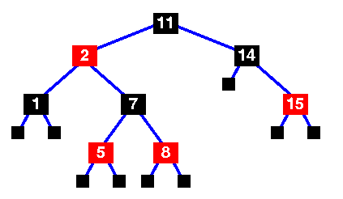
Example
bh(x)=2
h(x)=4
here
h(x) > bh(x)
i.e. 4> 2
and
bh(x)=h(x)/2
i.e. 2=2
Hence , Lemma 1 holds true.
Niyati

Slide 6
Second Lemma of RB TREE
Suppose a Red – Black tree has a subtree routed at any node ‘x’ contain at least 2^bh(x)-1 internal nodes where bh(x) is the black height of node ‘ x ’
Now we will proof this claim by mathematical induction
Base Case : bh(x)=0
If ‘ x’s ‘ height is then also black height of ‘ x ‘ is 0.
=> bh(x)/h(x)=0
so, 2^bh(x) -1 => 2^0 -1 => 0
somya

Slide 7
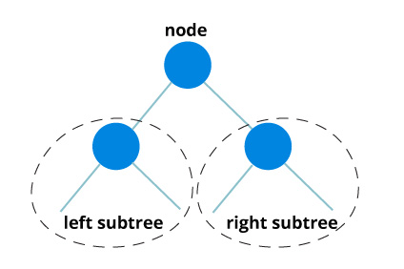
RHS = 2^0-1 = 0
=> It means there are 0 internal nodes in the tree.
Inductive Case : bh(x) > 0
Bh(l) and bh(x)
If c(x) = B, then c(l)=B
Then ,
bh(x) =bh(l)+1
Bh(l) and bh(x)
If c(x) = R , then c(l)=B
Then ,
bh(l) =bh(x)-1

Slide 8
Bh(x) > bh(l) or bh(r)
Let ‘ nL ‘ be the no of nodes present in the left subtree
Let ‘ nR ‘ be the no of nodes present in the left subtree
nL= 2^ bh(l) -1
nR= 2^ bh(r) -1
nL>= ((2^ bh(x) -1) -1)
nR>= ((2^ bh(x) -1) -1)
n= nL + nR + 1
n= ((2^ bh(x) -1) + ((2^ bh(x) -1) -1) + 1
n= 2^ bh(x) -1
Somya

Slide 9
To prove other side of the statement we do ,
Claim : n < 2^(h(x))
Proof : we take the height of a BST :
minimum height of a BST is :
min ht = log n
h(x) = log n
taking 2 ^ on both the sides
2 ^h(x) = 2 ^ log n [log property : log 2 n = x]
2 ^ h(x) > n [2 ^ n = x]
=> n < 2 ^ h(x)
Somya

Slide 10
Third Lemma of RB TREE lemma: log(n)< h(x) <= 2log(n+1)
By first lemma
it was proved that b(x) cannot be less than h(x)/2
i. e. it is greater than log(n).
Jagriti

Slide 11
To prove right side of lemma
Claim : h(x) <= 2log(n+1)
let, n >= 2^bh(x) – 1
n+1 >= 2^bh(x)
Taking log on both sides,
log(n+1) >= bh(x)
Also, bh(x)>=h(x)/2
log(n+1) >= h(x)/2
=> 2log(n+1) >= h(x)
Jagriti

Slide 12
To prove left side of lemma
Claim : log(n)< h(x)
From lemma 2, we know that,
n < 2^h(x)
Now taking log on both sides,
=> log(n) < h(x)
Jagriti

Slide 13
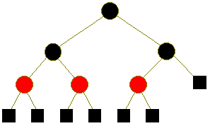
Example :
n = 2
h(x) = 3
therefore, log n = 1
and, 2log(n+1) = 3.16
=> log(n) < h(x) <= 2log(n+1)
Hence, lemma 3 holds true.
Jagriti

Slide 14
Deletion in RB TREE
There can be 4 possible cases for deletion :
1.
Nil x
x
when we delete z node ,it is replace by x that is the r node. Niyati
z
r
r

Slide 15
When z node is deleted, it is replaced by x node that is by l node.
2.
x Nil
Niyati
z
l
l

Slide 16
when z node is deleted , it is replaced by it’s successor which is the smallest of all the successor’s that is y .
3.
Nil
Niyati
z
y
l
y
l
x
x

Slide 17
When node z is deleted , the smallest of the successor’s is replaced . It would search in the right side of the tree and if the right node have a left node or node’s , it would pick from that part because we want the smallest of successor’s which would be on the left of the right node of z.
Nil x Niyati
z
y
l
r
l
r
y
x
x

Slide 18
The Transplant Algorithm of RB TREE
RB-Transplant( T , u, v )
if( u . p == Nil)
T . root = v
else if( u == u . p . right)
u . p . right = v
else
u . p . left = v
v . p = u . p
Niyati

